Slide 1
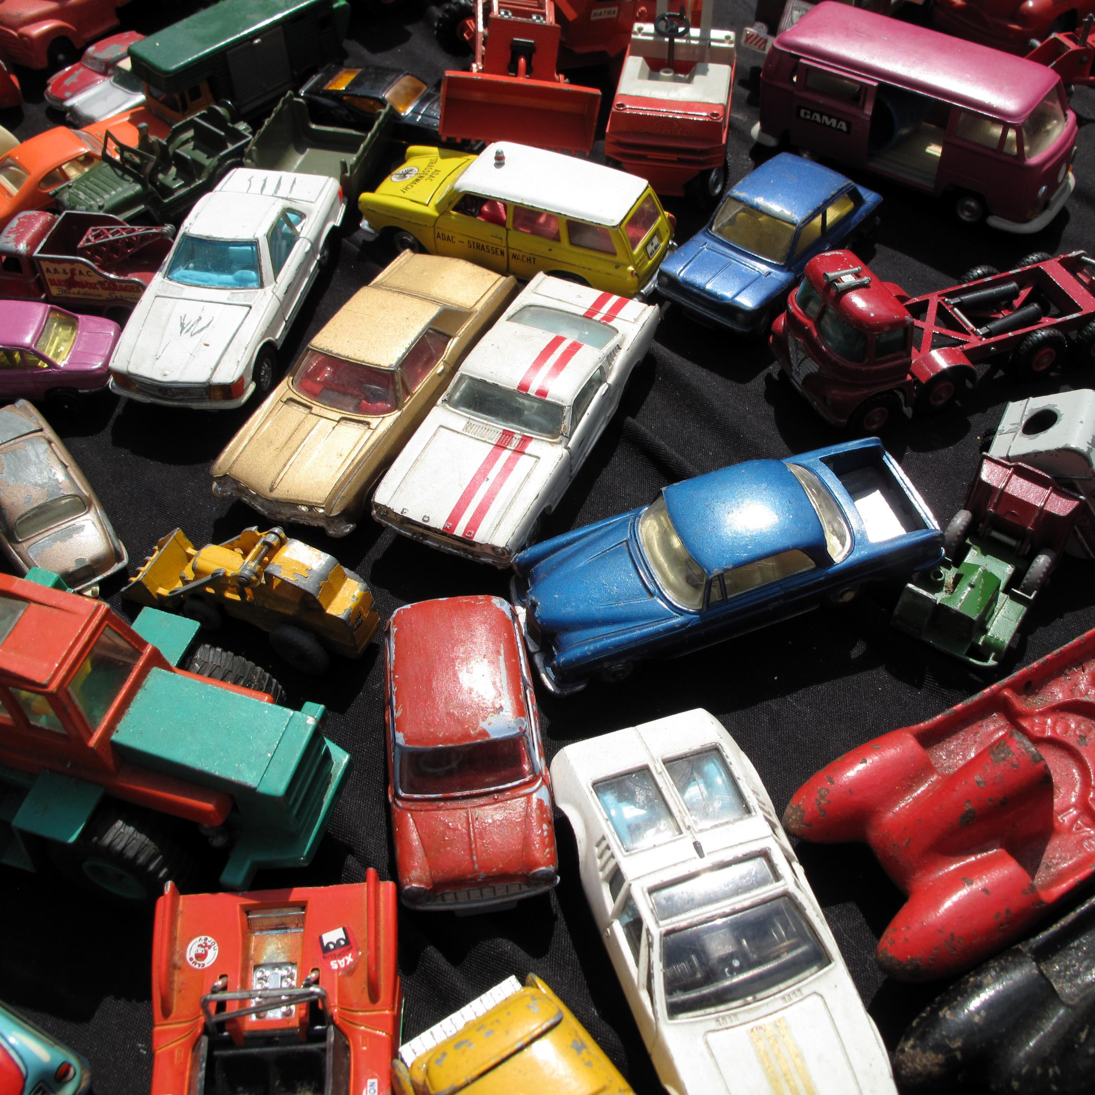
Stanford Cars Dataset
Noa Chu Artzt

Slide 2
ÍNDICE
Dataset
Preprocesado
Modelos
LeNet
Autoencoder
AlexNet
VGG16
GoogleNet y Inception
ResNet

Slide 3
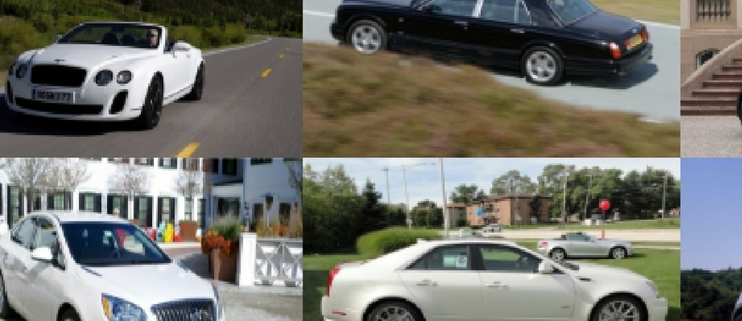
Kaggle - Stanford Car Dataset by classes folder

Slide 4
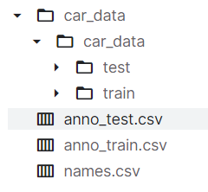
Kaggle - Stanford Car Dataset by classes folder
16.185 imágenes
196 clases
8.144 de entrenamiento
8.041 de testeo

Slide 5
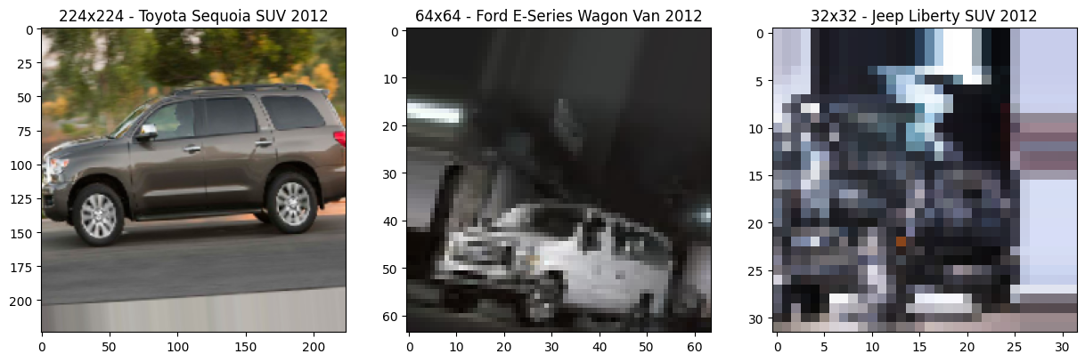
Preprocesado
TARGET_SIZE = 227, 224, 64, 32
BATCH_SIZE = 128, 64, 32, 16, 8
ImageDataGenerator(rescale, rotation_range, width_shift_range, height_shift_range, horizontal_flip, zoom_range, fill_mode, validation_split)
flow_from_directory(train_path, target_size, class_mode, subset)

Slide 6
Modelos CNN

Slide 7
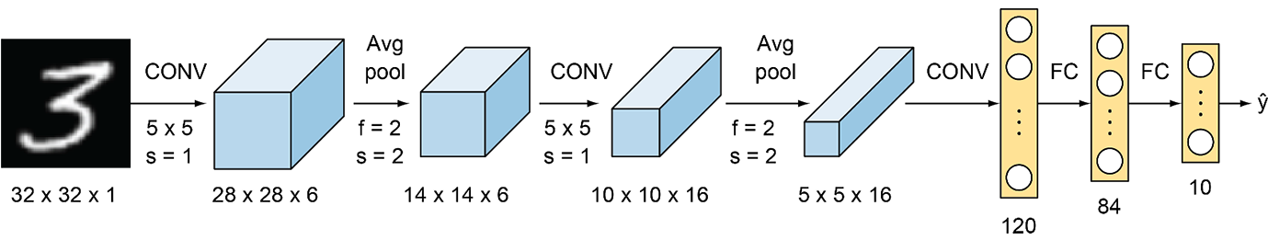
LENET
Loss: 5.06
Accuracy: 2.98%

Slide 8
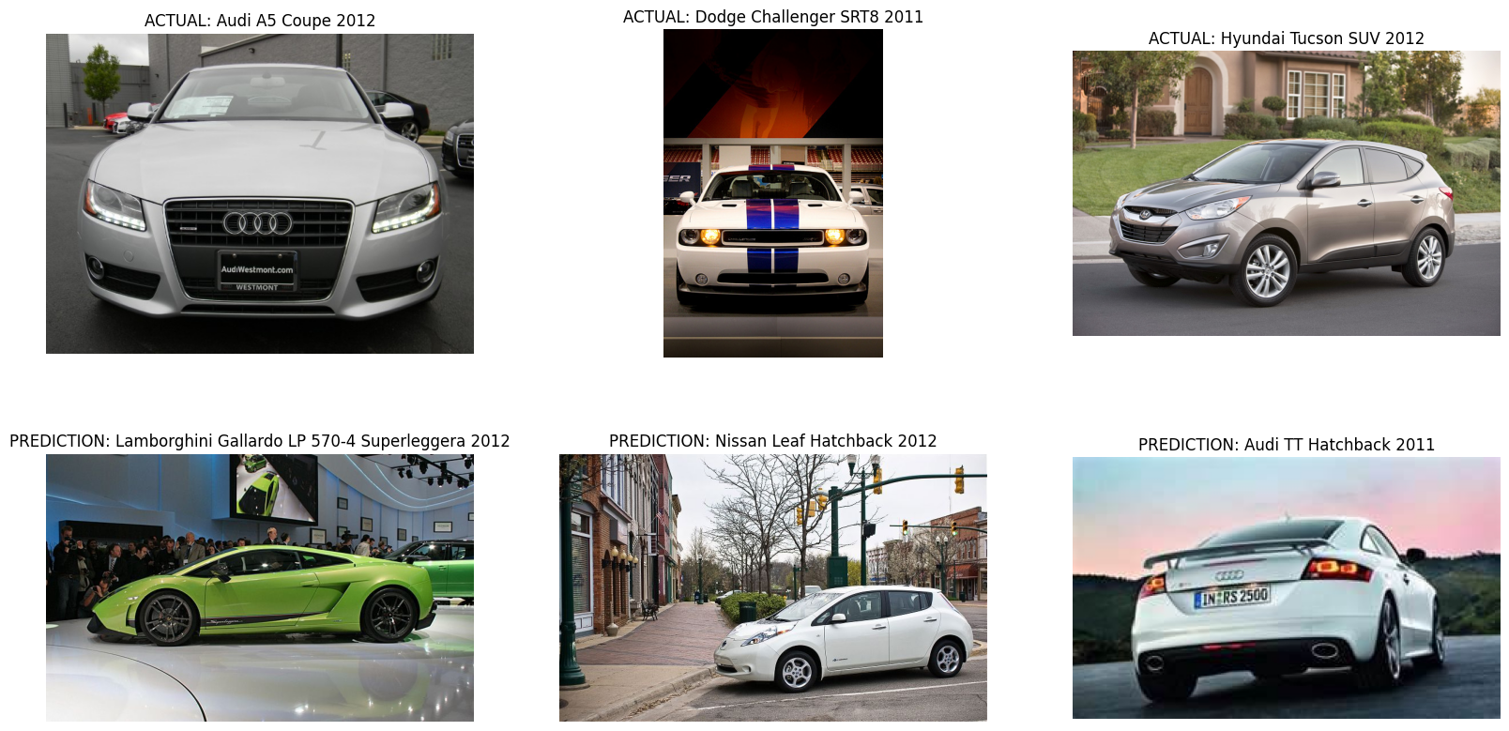
LENET

Slide 9
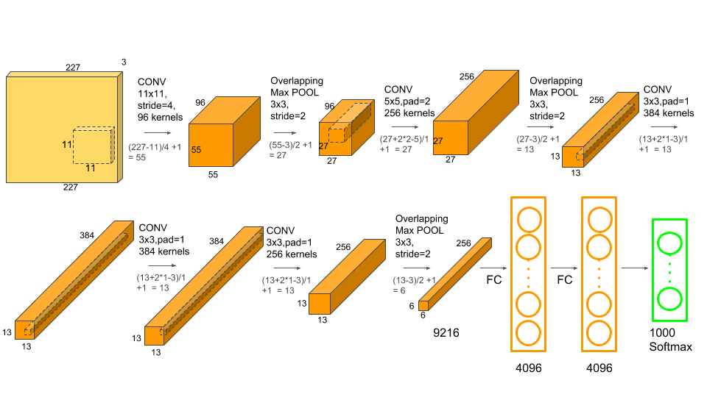
ALEXNET
Loss: 5.27
Accuracy: 0.83%

Slide 10
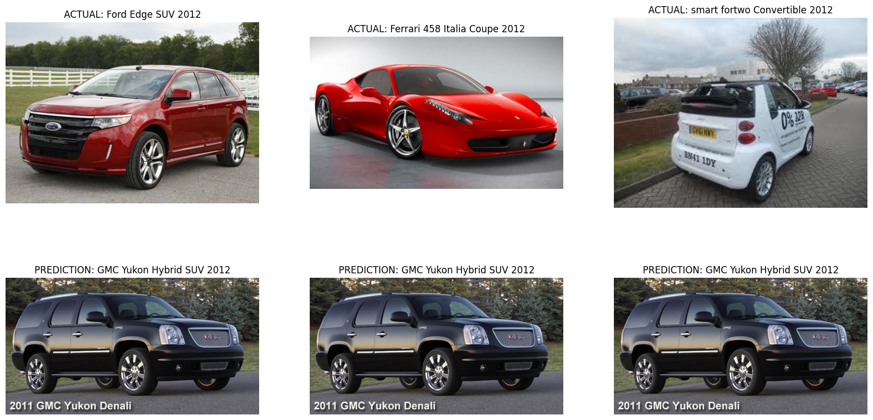
ALEXNET

Slide 11
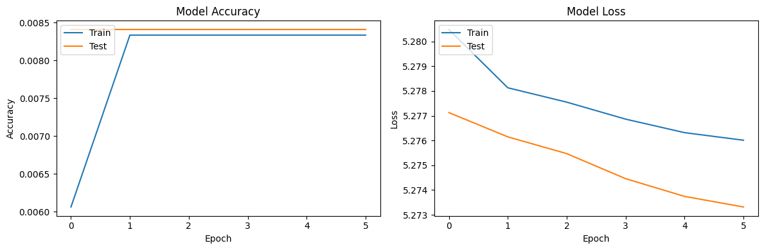
RESNET
Loss: 5.28
Accuracy: 0.85%
GoogleNet + Inception
Loss: 5.28
Accuracy: 0.85%
VGG-16
Loss: 5.27
Accuracy: 0.83%

Slide 12
Transfer Learning

Slide 13
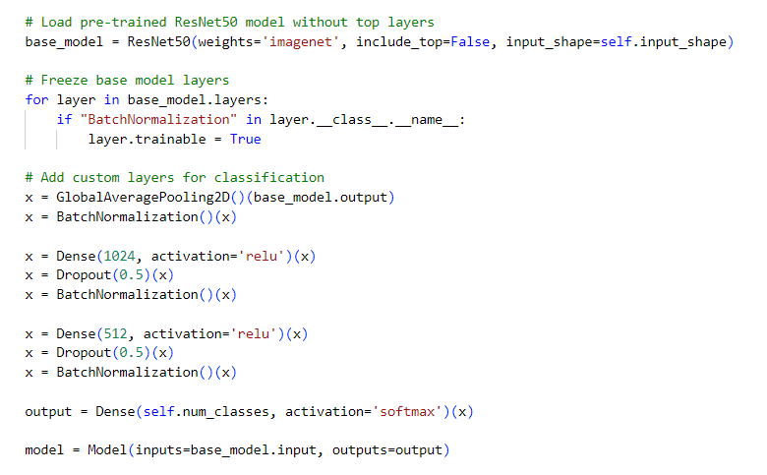
RESNET-50
Loss: 1.12
Accuracy: 70.65%

Slide 14
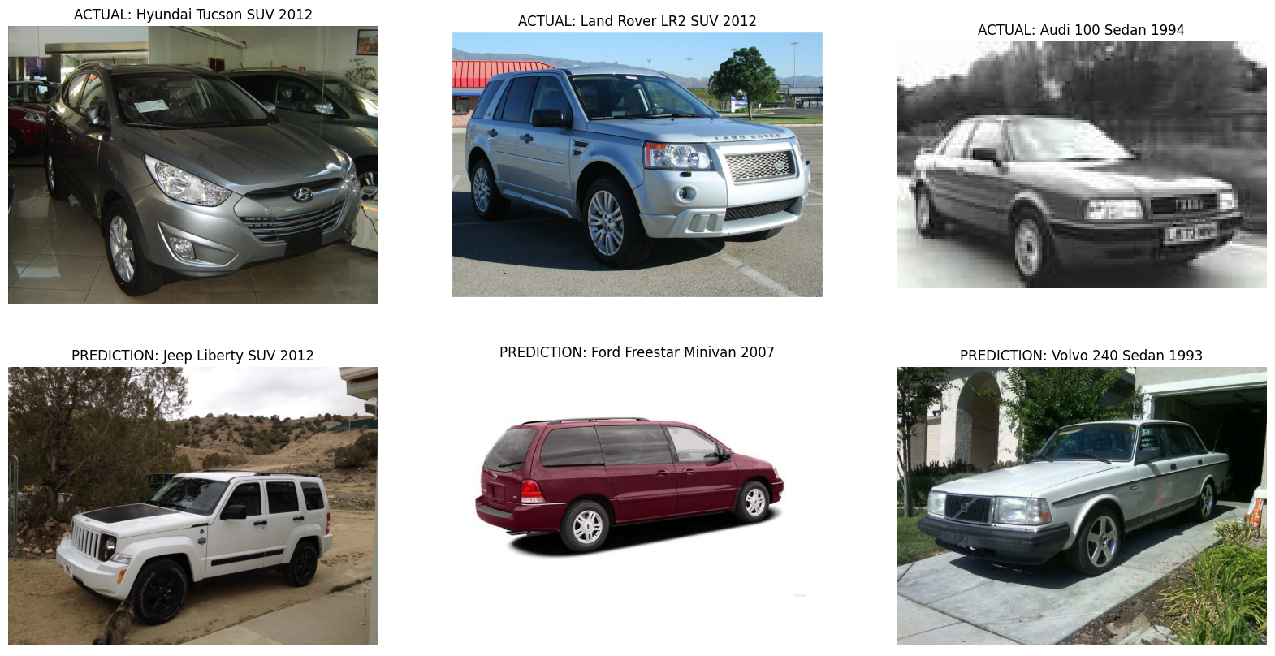
RESNET-50

Slide 15
Autoencoder

Slide 16
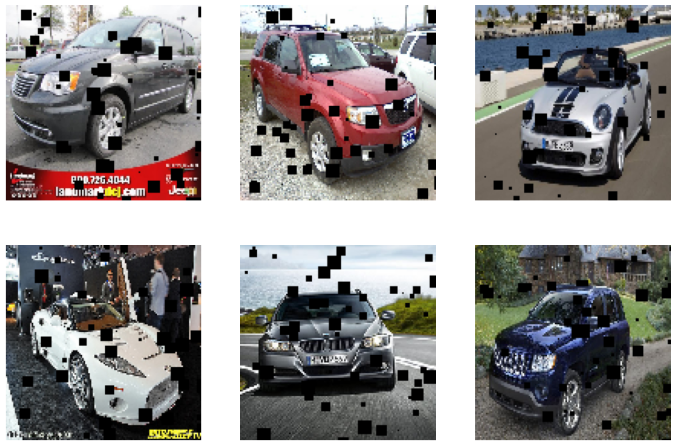
Perturbación de las imágenes con ruido

Slide 17
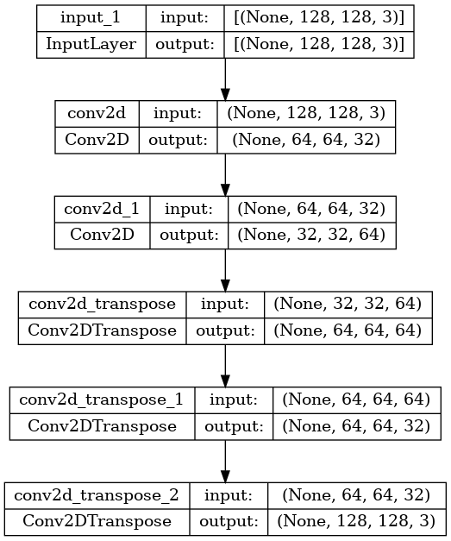
ARQUITECTURA
loss: 6.9119e-04 - accuracy: 0.7632 - val_loss: 6.0662e-04 - val_accuracy: 0.7647

Slide 18
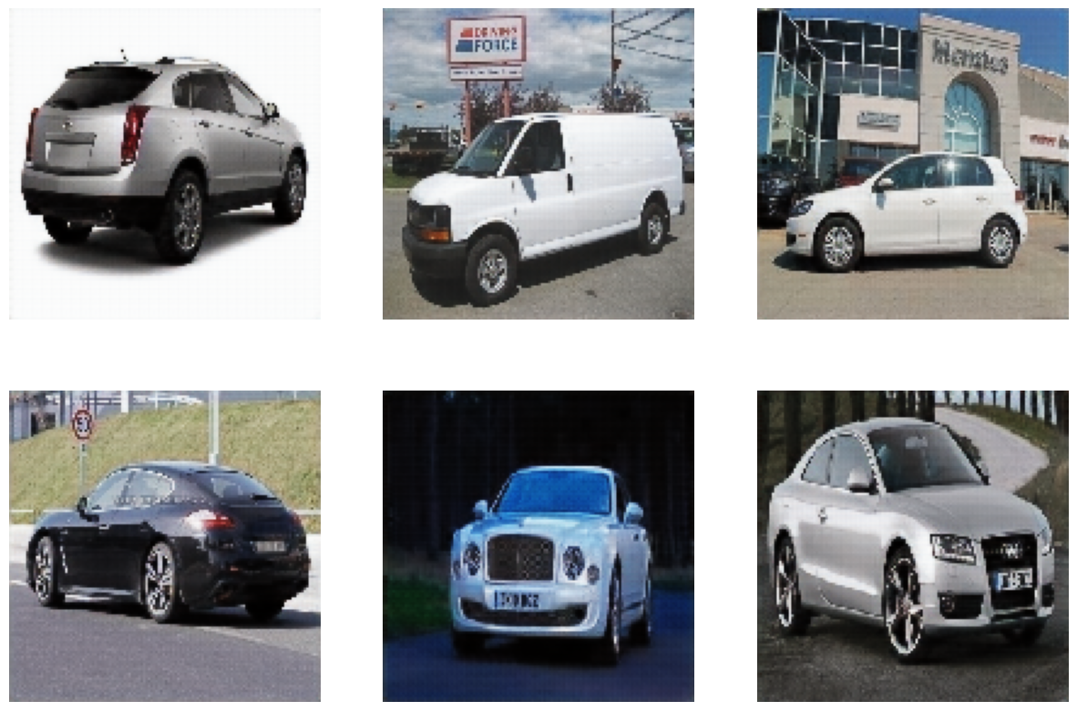
RESULTADOS

